Slide 1


BUILD A TEAM OF AUTONOMOUS AI AGENTS IN COPILOT STUDIO

Slide 2







Story!
It is 2025! The hospital floor, which Nike once dominated, has been taken over by Hoka and Crocs.
Nurses are choosing "ugly comfort" over the "Swoosh."
The Board of Directors at Nike have greenlit the Nike Air Zoom Pulse 2, a shoe re-engineered specifically for the 12-hour shift.
The goal is to build an AI Marketing Team using Copilot Studio that will autonomously research the competition, find viral trends, and write the launch campaign to win back the hospital floor.
© All rights reserved for Dr. Ryan Ahmed @Stemplicity Inc.

Slide 3



Project overview
User Trigger
Chief Marketing Officer (CMO)
Marketing Analyst
Social Media Manager
© All rights reserved for Dr. Ryan Ahmed @Stemplicity Inc.
Creative Copywriter

Slide 4
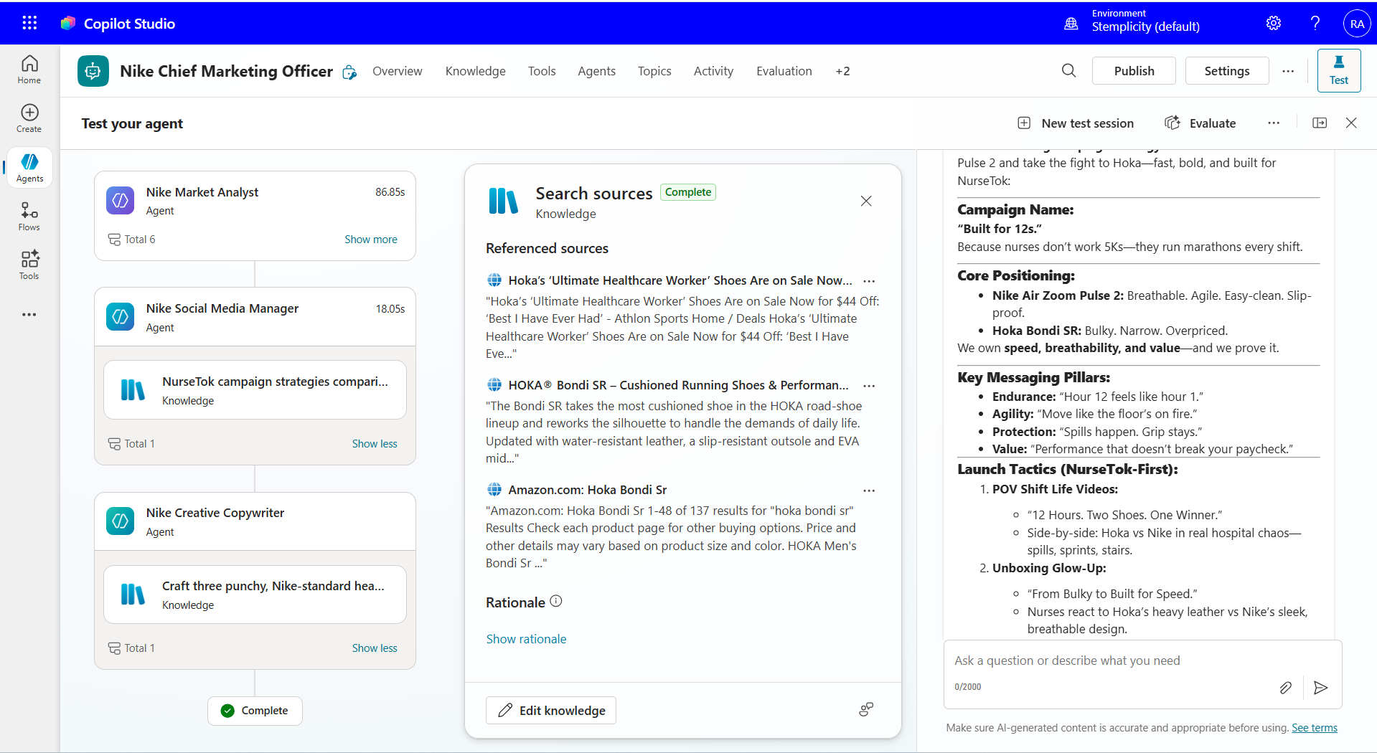
Marketing Team Sample Output

Slide 5

Key Learning Outcomes
Build a team of Autonomous AI Agents in Copilot Studio.
Learn how to add and configure child Agent to a master Agent.
Learn how to select multiple Models with different degrees in Reasoning.
Compare LLMs using various leaderboards such as Vellum.
Learn Agent to Agent feature in Copilot Studio
© All rights reserved for Dr. Ryan Ahmed @Stemplicity Inc.

Slide 6
PRACTICE OPPORTUNITY

Slide 7

Practice Opportunity
You are now tasked to create a Project Manager Agent and add it to the team.
The agent goal is to create a complete, structured launch schedule for the Nike Air Zoom Pulse 2 campaign, outlining every phase of the marketing workflow from start to finish. Your purpose is to convert the team's strategy into a clear, time-bound execution plan. This agent coordinates the flow of work across all other agents and ensures the launch stays on track.
Tasks:
1. Create a New Agent
2. Publish & Connect
3. Update the CMO Workflow
Modify the CMO instructions so that after generating the final marketing assets, it asks the project manager to develop a launch schedule.
4. Test the Orchestration
Use the same trigger phrase to run the full team flow and confirm the CMO calls the Translator at the end.
© All rights reserved for Dr. Ryan Ahmed @Stemplicity Inc.

Slide 8
LEADERBOARDS FOR OPEN & CLOSED-SOURCE MODELS

Slide 9



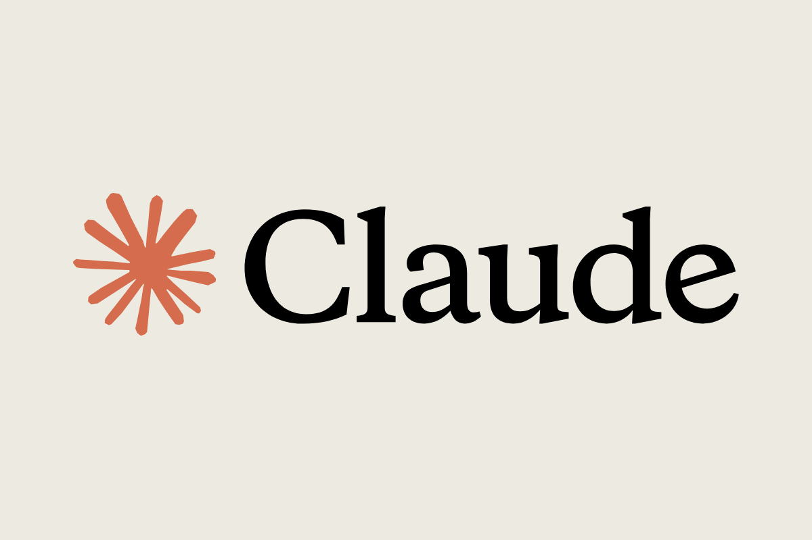


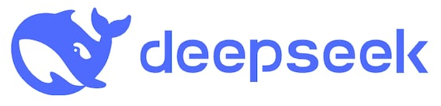
AI Models (LLMs) are everywhere!
Many LLMS are available, some are open source, and some are closed source. Which one should I go for?
© All rights reserved for Dr. Ryan Ahmed @Stemplicity Inc.

Slide 10
How to Compare LLMs?
Open-source or Closed
Closed (e.g. GPT-4) usually offers better performance and ease of use via APIs.
Context Length
How much input/output the model can handle in one go.
For long documents or multi-turn conversations, longer context is better (e.g., Gemini 2.5 Flash has 1M Window).
Release Date & Knowledge Cut-off
Newer models are trained on more recent data (useful for current events) (e.g.: GPT-3.5’s cut-off is early 2023.
Parameters
More parameters usually = more capacity (e.g., GPT-3 has 175B).
But bigger isn’t always better for performance or cost—efficiency matters too.
Training Tokens
Refers to how much text the model was trained on.
More tokens = broader language understanding and generalization
Open-source (e.g. LLaMA) gives you flexibility, full control, and lower cost if self-hosted.
© All rights reserved for Dr. Ryan Ahmed @Stemplicity Inc.

Slide 11
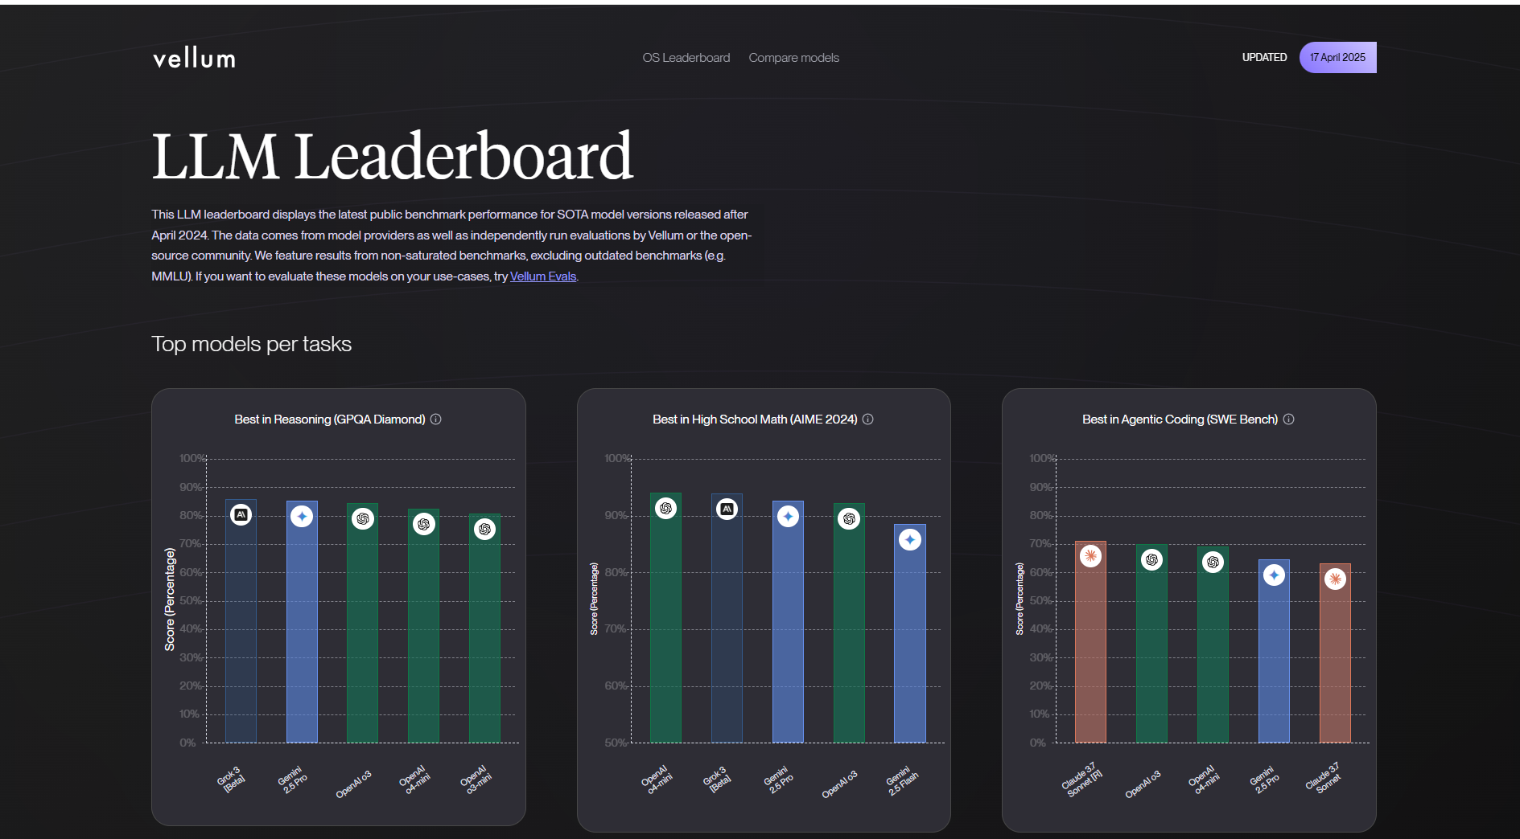
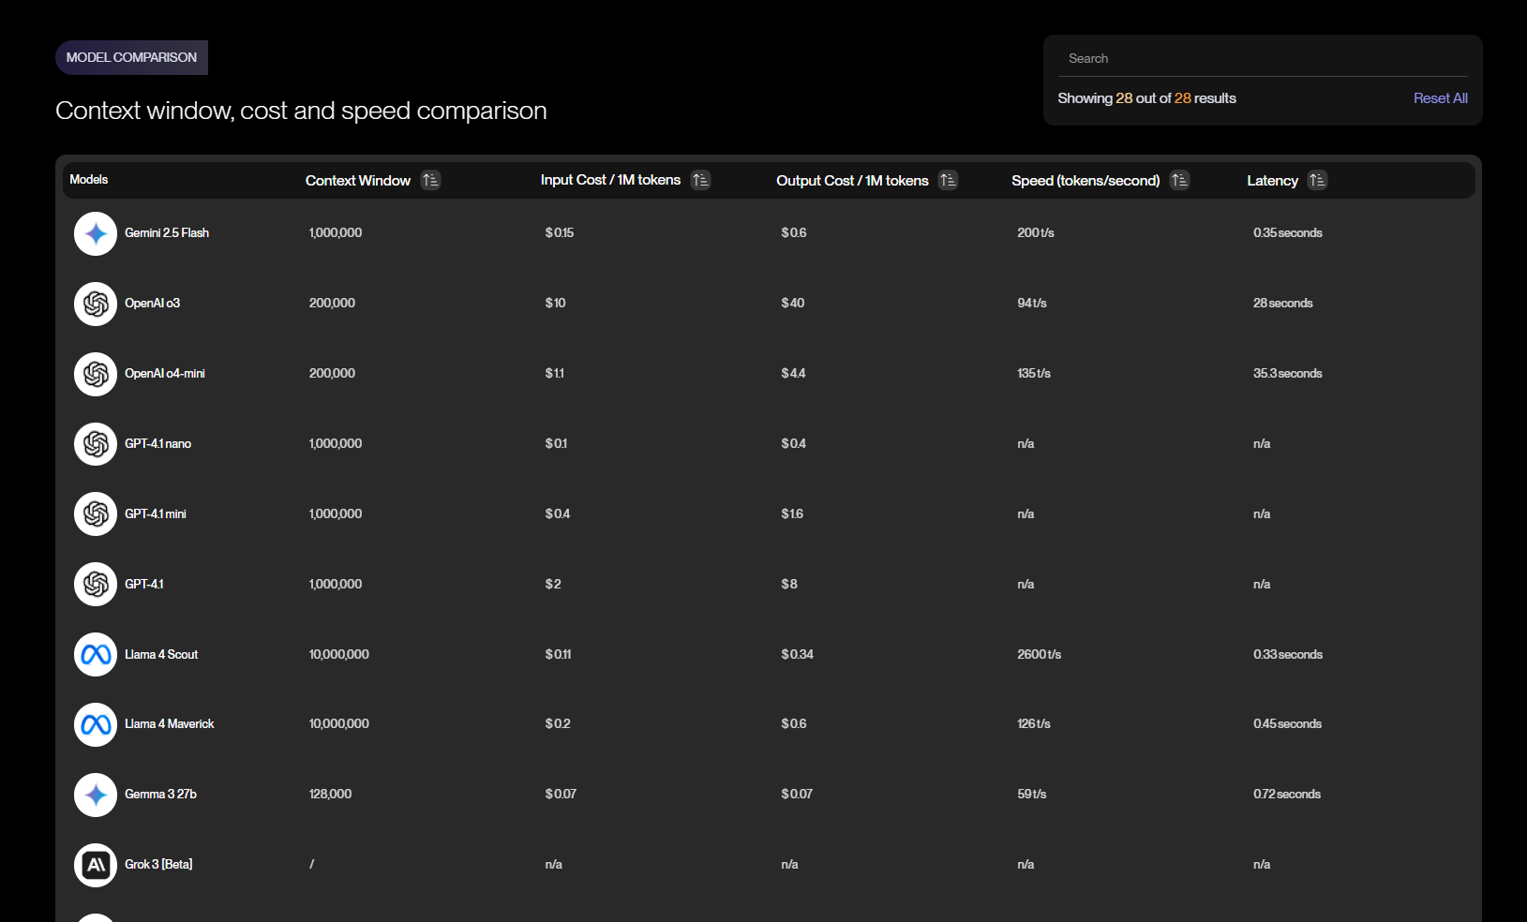
Vellum Leaderboard & Key KPIs
Vellum Leaderboard: https://www.vellum.ai/llm-leaderboard
© All rights reserved for Dr. Ryan Ahmed @Stemplicity Inc.

Slide 12
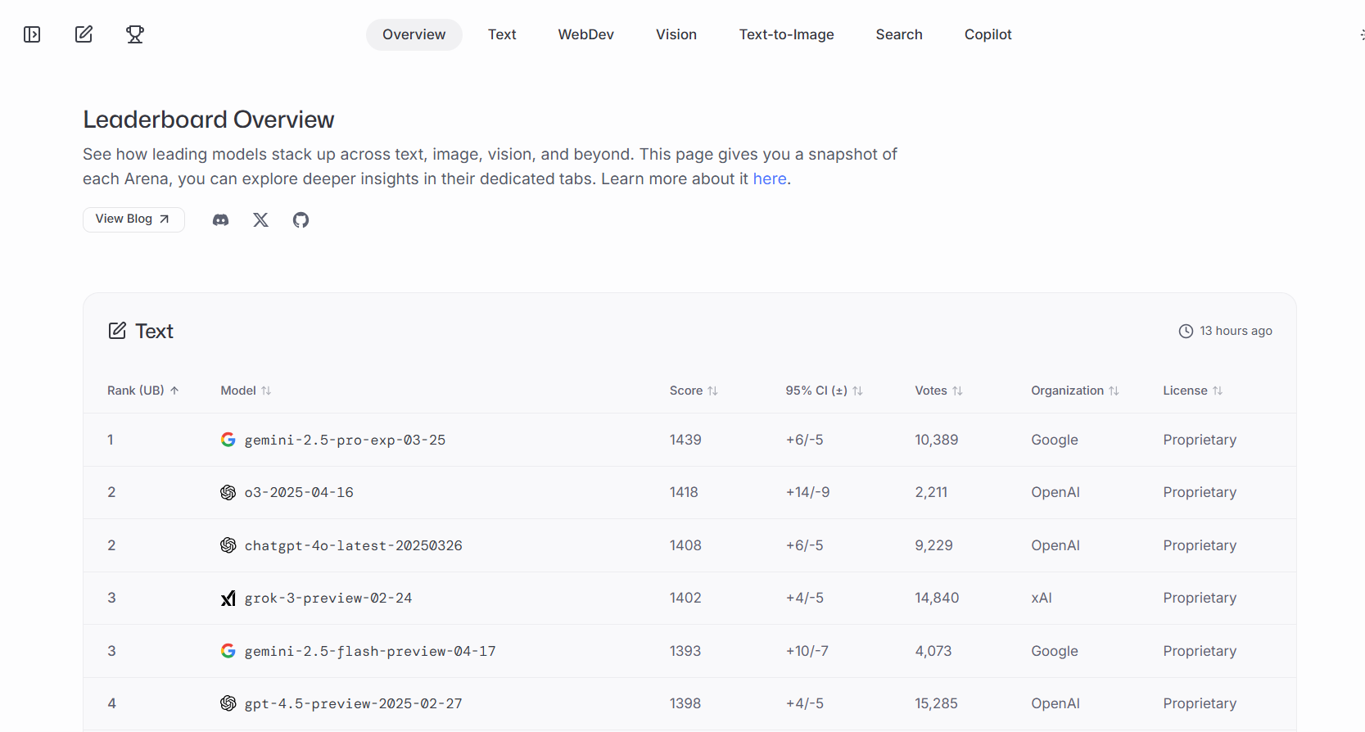
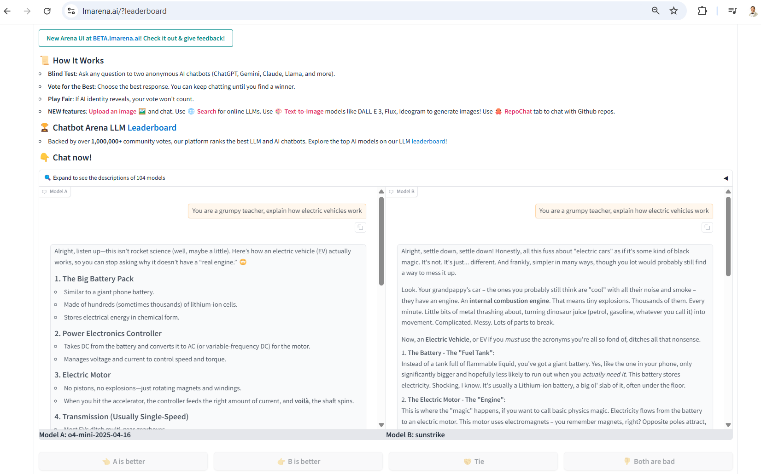
Chatbot Arena LLM Leaderboard & Blind Test!
Chatbot Arena (old): https://lmarena.ai/?leaderboard
Chatbot Arena (New): https://beta.lmarena.ai/leaderboard
© All rights reserved for Dr. Ryan Ahmed @Stemplicity Inc.

Slide 13

Summary
Developed the ability to build a coordinated team of autonomous AI Agents within Copilot Studio.
Mastered the Agent-to-Agent interaction feature to enable seamless communication between agents.
Learned how to add, configure, and manage child Agents under a master Agent for complex multi-agent workflows.
Gained skill in selecting and combining multiple LLMs, each with different reasoning strengths, to optimize agent performance.
Explored how to compare LLM performance using external leaderboards (e.g., Vellum) to make informed model-selection decisions.
© All rights reserved for Dr. Ryan Ahmed @Stemplicity Inc.

Slide 14
Thank you!

